Slide 1
Warm Up
1. What is true of the sun in a geocentric model?
a. It hovers in a fixed position in the sky
b. It revolves around Earth
c. It dims and brightens periodically
d. It stands at the center of the universe
According to Copernicus, the rising and setting of the sun is due to:
a. Its own movement
b. The movement of stars and planets
c. Earth's tilt
d. Earth's rotation
The Copernican Revolution marked an ideological shift toward:
a. Direct observation
b. Spiritual faith
c. Christian doctrine
d. Greek wisdom

Slide 2
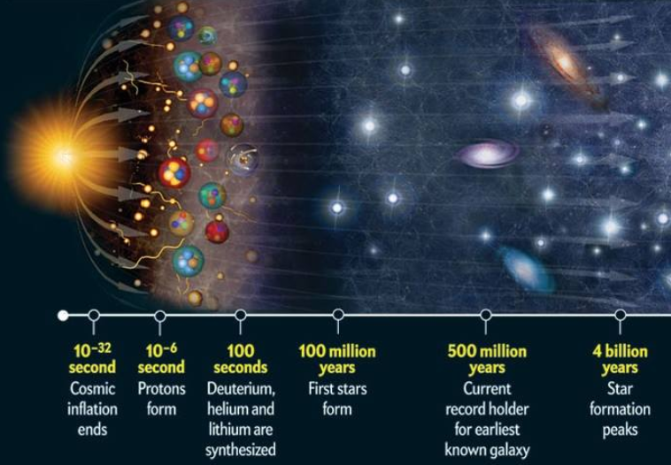
How was the Universe Formed?
Brainpop

Slide 3
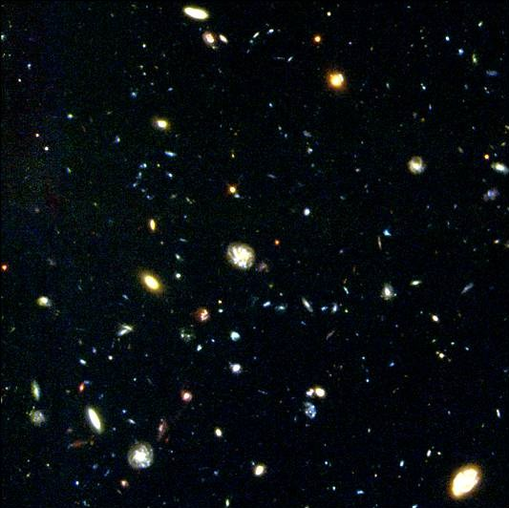
Image from Hubble Telescope

Slide 4
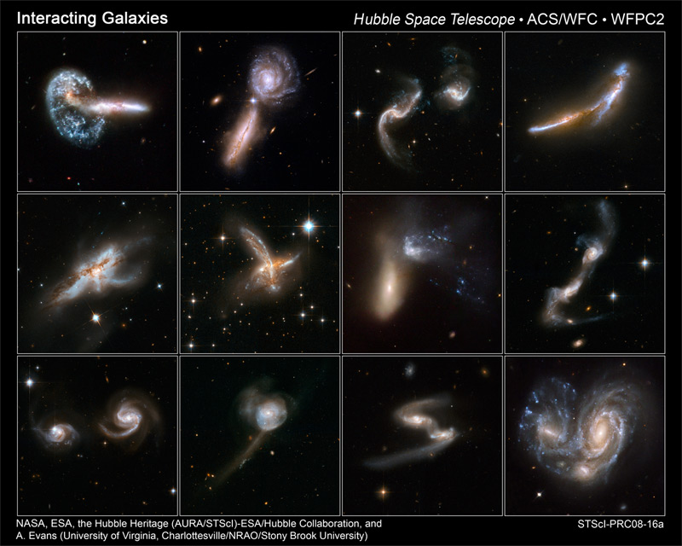
Galaxies
Brainpop video
a large group of gas, dust, and millions of stars.
Irregular – young stars with no shape
Spiral - middle aged stars
Elliptical – round or flat spheres, older stars
Gravity keeps galaxies together
Blackholes exist in the center of most galaxies
Speeding away from each other

Slide 5
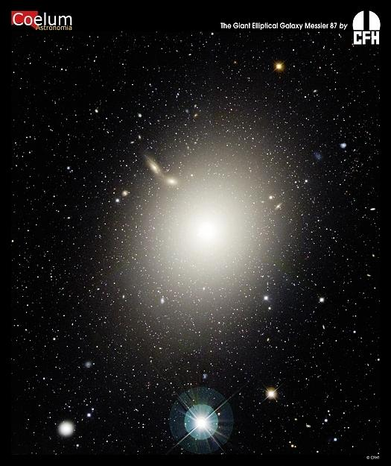
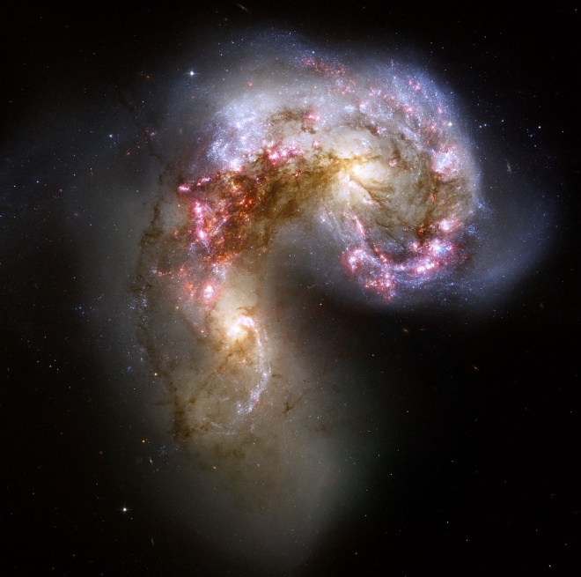
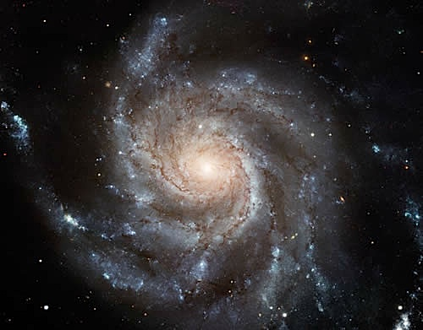
3 Galaxy Shapes:
SPIRAL - most galaxies
Elliptical - older stars
Irregular - younger

Slide 6
The Milky Way--Brainpop

Slide 7
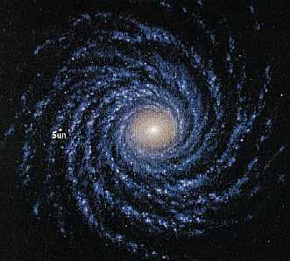
Milky Way Galaxy (about 100-300 billion stars) (ly=light year=DISTANCE light travels in 1 year=6 trillion miles)
about 100,000 ly wide and about 2,000 ly thick
we are 30,000 ly from the center (or 250 million billion km)
takes us 230 million years to make one orbit (revolution)
Our closest galaxy is Andromeda Galaxy (2 million ly away)
Spiraling arms
Contains oldest stars
DYK: If every star in the Milky Way was a grain of salt, they
would fill an Olympic sized swimming pool.

Slide 8
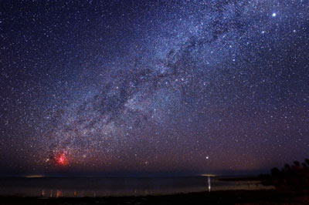
Milky Way as seen from Earth

Slide 9
Our solar system is located in the Milky Way. Which one of the following statements best describes the Milky Way?
A. a nebula containing about 200 billion stars
B. a spiral galaxy containing about 200 billion stars
C. an irregular galaxy containing about 200 billion stars
D. an elliptical galaxy containing about 200 billion stars

Slide 10
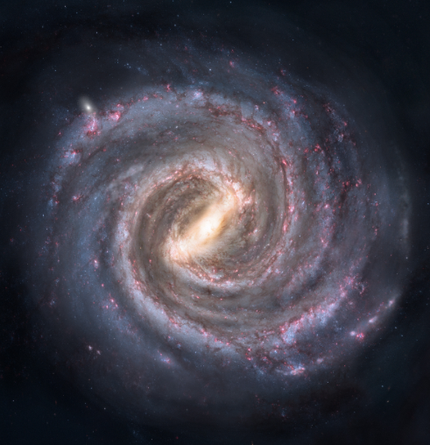
Where in the Milky Way is our solar system located?
A. in the center of the Milky Way
B. in a nebula in the Milky Way
C. in a spiral arm of the Milky Way
D. in a nova in the Milky Way

Slide 11
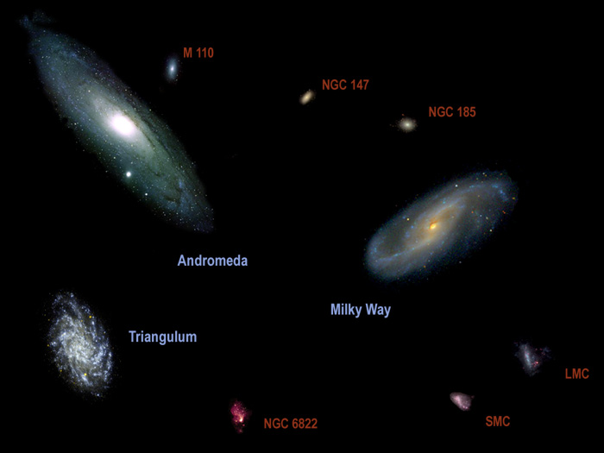
Galaxies exist in groups called CLUSTERS
Our Milky Way belongs to a cluster of 32 galaxies called the Local Group.
The Milky Way is the second largest galaxy in this group (Andromeda is the largest).
Clusters group together to form superclusters.

Slide 13
Earth vs. The Universe
https://www.youtube.com/watch?v=1Eh5BpSnBBw

Slide 14
Less Wrap Up
Which object is the largest: Earth, the sun, the Milky Way Galaxy, supergiant star?
Where in the Milky Way Galaxy is the solar system found?
A light year is a unit of _________.

