Slide 1
Astronomy
Day 1

Slide 2
Review from Day #1, then quiz
astronomy
rotation
tilt
axis
day/night
revolution
orbit
elliptical
gravity
inertia
season
equinox
solstice
www.http://ed.ted.com/lessons/reasons-for-the-seasons-rebecca-kaplan

Slide 3
In your notebook (on a piece of paper), define, describe or sketch today’s vocabulary—use page 555 & 600
theory
Geocentric model
Heliocentric model
Big Bang
universe
galaxy
solar system
AC: also read pages 601-603

Slide 4
Theories about the center of the universe— make a double bubble
A theory is an explanation of related observations.
Geocentric
EARTH centered
(sun, moon, stars, planets revolve around Earth)
Believed until 1500 AD
Early cultures and Ptolemy
Heliocentric
Sun centered
(planets and comets revolve around the sun)
1500 AD to present
Copernicus*, Galileo, Kepler, Newton
Are either correct?—Helio is mostly correct

Slide 5
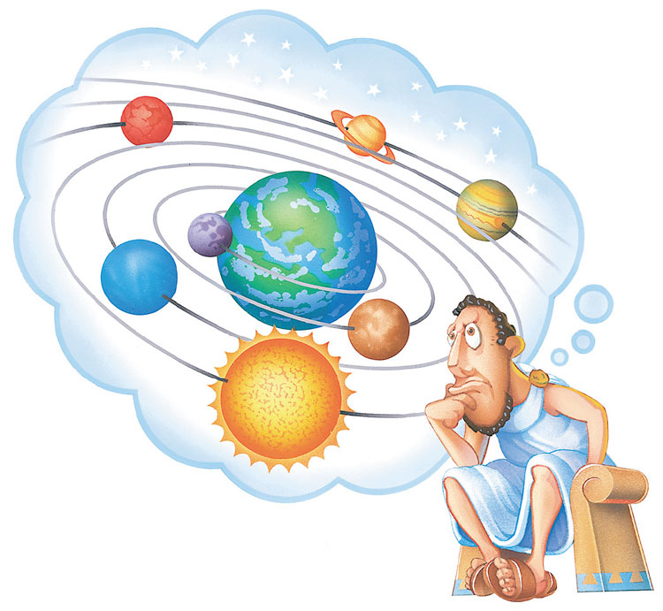
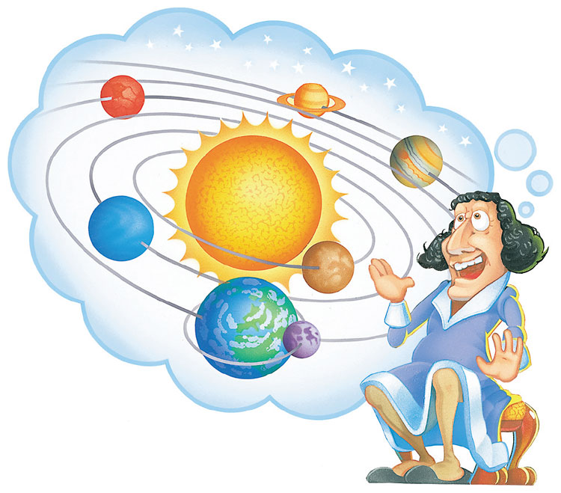
Ptolemaic theory
(geocentric)
Copernicus’s theory
(heliocentric)

Slide 6
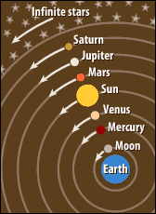
Review question
What did the geocentric theory state? Is this theory correct?
>>Earth is at the center of the solar system
(incorrect)

Slide 7
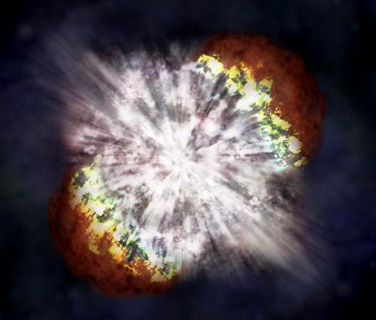
Big Bang Theory (theory of the formation of the Universe --1950)
matter, time and energy were compressed into an extremely small ball (very unstable)
exploded about 13-14 BILLION years ago
DYK: Every hour the Universe expands by a billion miles in all directions.
Brainpop: Big Bang

Slide 8
Brainpop: Galileo
Discuss:
Universe
Galaxy
Solar System
Planets
make a space timeline: http://nssdc.gsfc.nasa.gov/planetary/chronology.html

