Slide 1
Plate Tectonics
Plate tectonics accounts for important features of Earth’s surface and major geologic events.

Slide 2
7-2 Alfred Wegener’s Hypothesis of Continental Drift (1915)
He noticed that the continents seem to fit together (not perfectly)
one single landmass called Pangaea (started splitting about 180 million years ago)
**Note: Rodinia is the name of the supercontinent that existed about 500 million years ago {enrich}
plant and animal fossil evidence
rock evidence

Slide 3
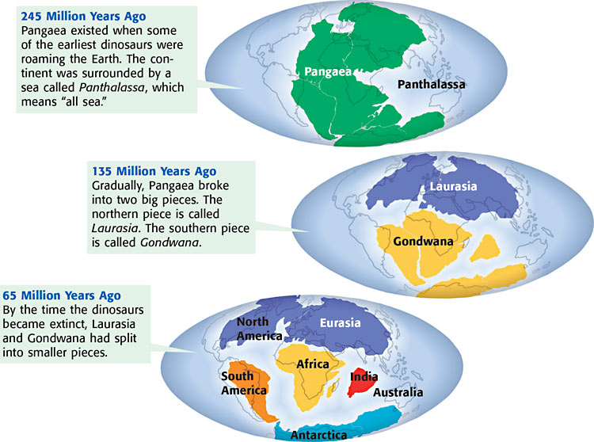

Slide 4
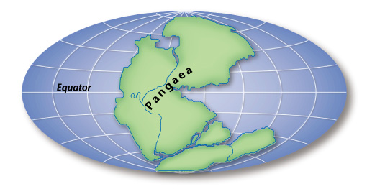
Continental Drift
225 million years ago

Slide 5
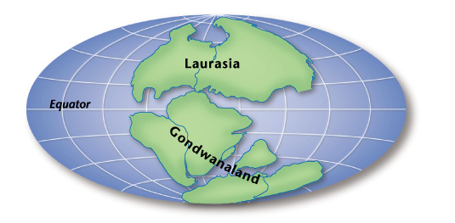
Continental Drift
180-200 million years ago

Slide 6
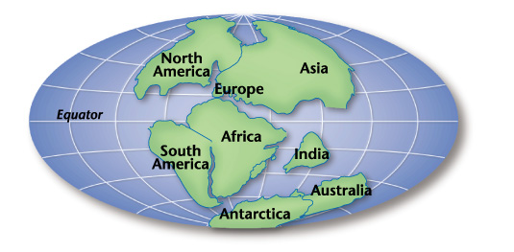
Continental Drift
135 million years ago

Slide 7
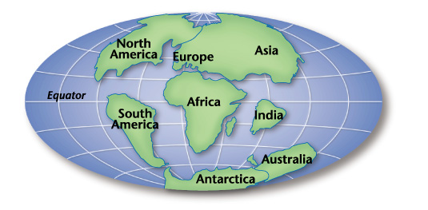
Continental Drift
65 million years ago

Slide 8
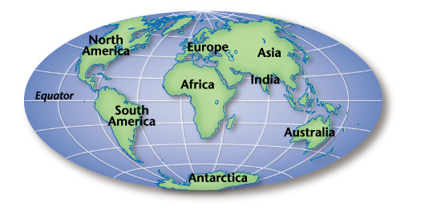
Continental Drift
Earth today

Slide 9
Fossil Evidence (climate and location of continents throughout history)
Ex: Mesosaurus
reptile
lived 250 million years ago
freshwater lakes, ponds, and rivers (could not live in salty ocean water)
fossils found in South America AND Africa
???How could this be????

Slide 10
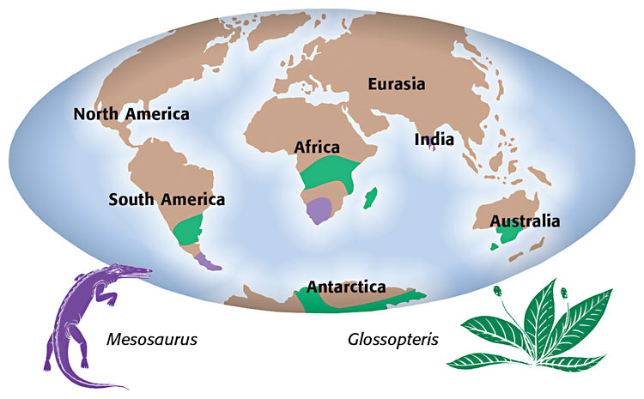
Fossil evidence

Slide 11
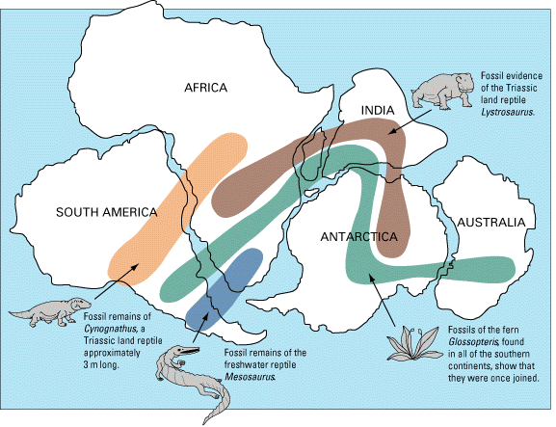

Slide 12
Put Pangaea together activity (look at the EVIDENCE)

Slide 13
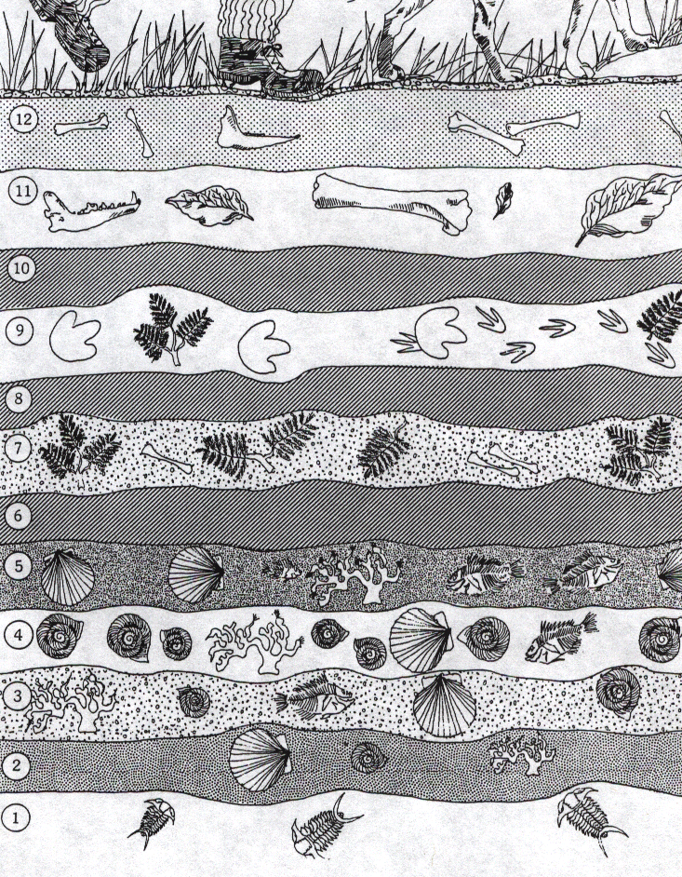
(law of superposition)
Youngest fossils near
the surface (get older
as you dig down)

Slide 14
How does fossil evidence support Wegener’s hypothesis of continental drift?
a. Similar fossils found on far apart landmasses suggest that the continents were once a single landmass.
b. Fossil evidence suggests that the continents have always been in their current position.
c. No similarities exist between fossils on different continents.
d. Plant and animal fossils show evidence of changes in Earth’s polarity.

Slide 15
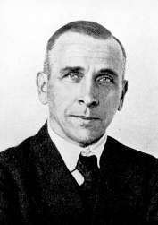
Sadly, most scientists did not accept Wegner’s hypothesis
because he could not explain HOW something as large as the continents (rocks) could be moved such a distance
he froze to death in 1930 during an expedition crossing the Greenland ice cap
…other evidence continued to be gathered by others

Slide 16
Review
Breakup of Pangaea (website) --(start with present day, then go backwards)
Continental Drift animation (website)

Slide 17
Important discoveries
1950’s: rocks on ocean floor younger than rocks that make up the continents—why???
1960’s: Harry Hess hypothesized “sea-floor spreading”
Then it was found that ocean rocks get older and older the farther they are from the crack (midocean ridge)

Slide 18
7-2 Sea Floor Spreading
see mid-Atlantic ridge on map (mostly submerged mountains) >>>sea-floor spreading occurs at these mid-ocean ridges
new ocean floor forms
may build above sea level (island)
plates are moving away from each other (older crust moves out)
Demonstrate Sea-floor spreading with entire class (rearrange the tables)
Interactive Animation of Seafloor Spreading and Magnetic Field Reversals (website)

Slide 19
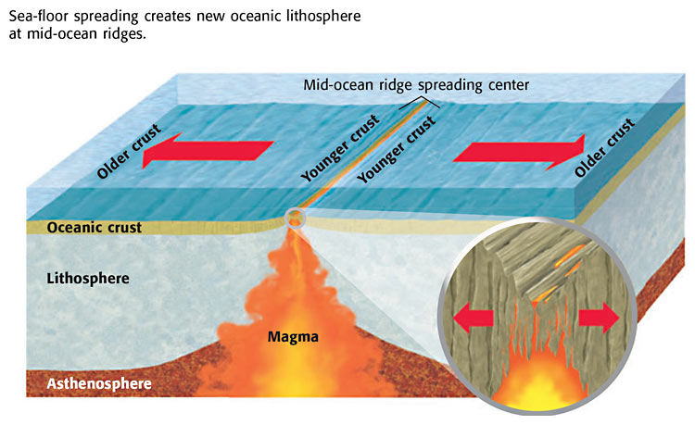

Slide 20
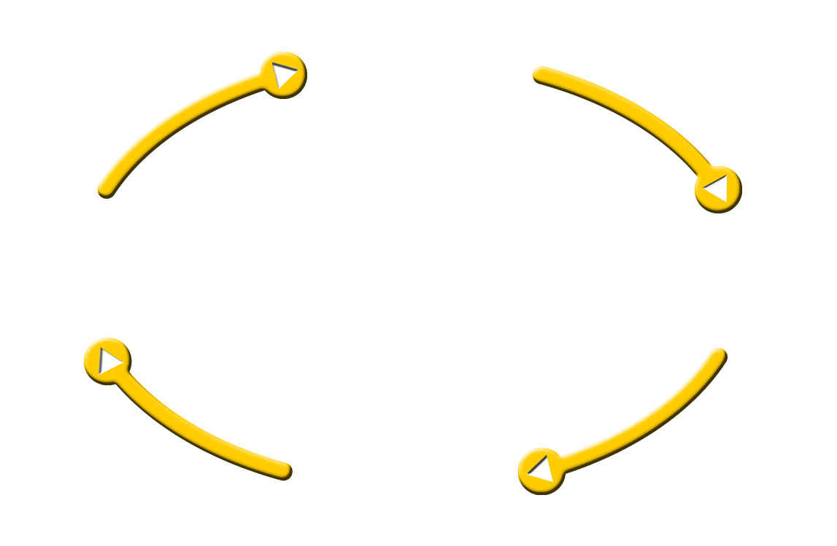
Sea-Floor Spreading
Oceanic crust
forms
subducted
through
Mid-ocean ridge
Deep-ocean trenches
erupts
through
Molten material
forms

Slide 21
Sea-Floor Spreading
Oceanic crust
forms
subducted
through
Mid-ocean ridge
Deep-ocean trenches
erupts
through
Molten material
forms

Slide 22
Sea-Floor Spreading
Oceanic crust
forms
subducted
through
Mid-ocean ridge
Deep-ocean trenches
erupts
through
Molten material
forms

Slide 23
Sea-Floor Spreading
Oceanic crust
forms
subducted
through
Mid-ocean ridge
Deep-ocean trenches
erupts
through
Molten material
forms

Slide 24
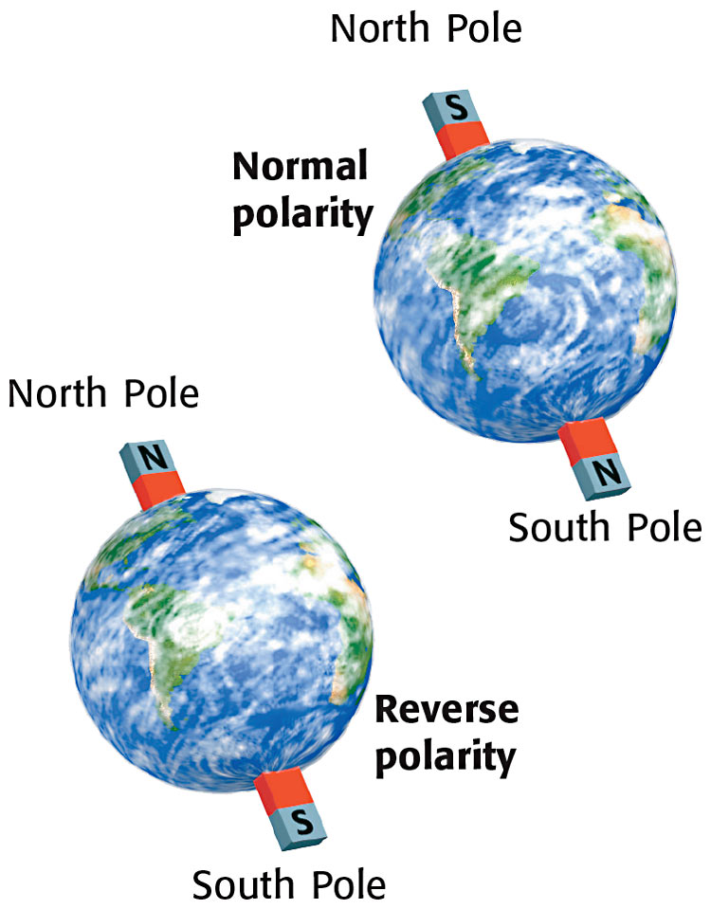
Magnetic reversal (iron in ocean rocks show this)—demo

Slide 25
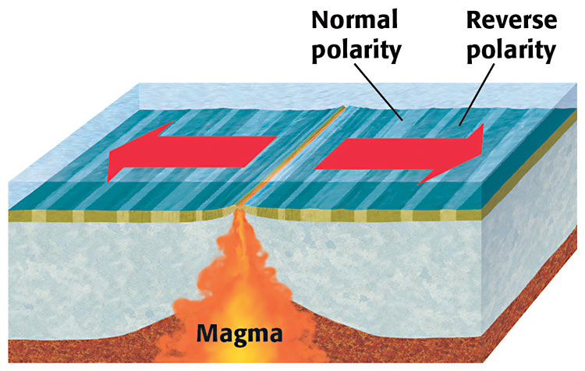

Slide 26
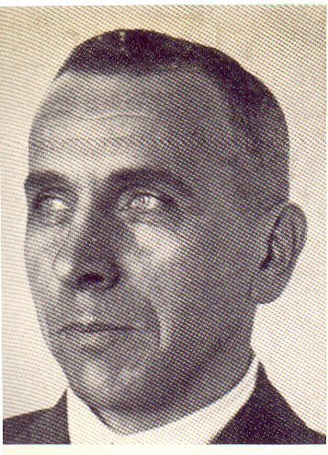
With lots of new evidence from MANY SCIENTISTS
Wegener’s Continental Drift hypothesis became the Theory of Plate Tectonics by the 1960’s

Slide 27
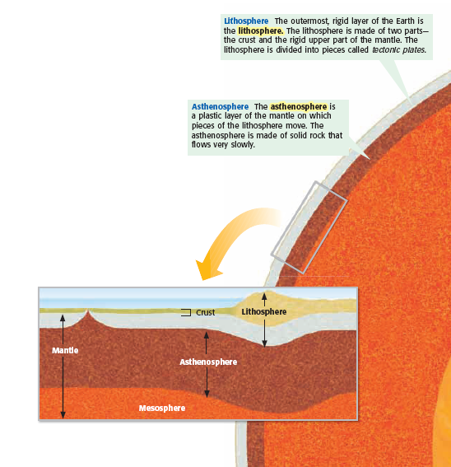
Review: Lithosphere and Asthenosphere

Slide 28
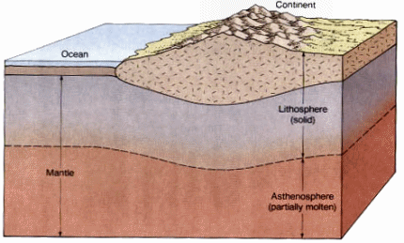
Lithosphere vs Asthenosphere

Slide 29
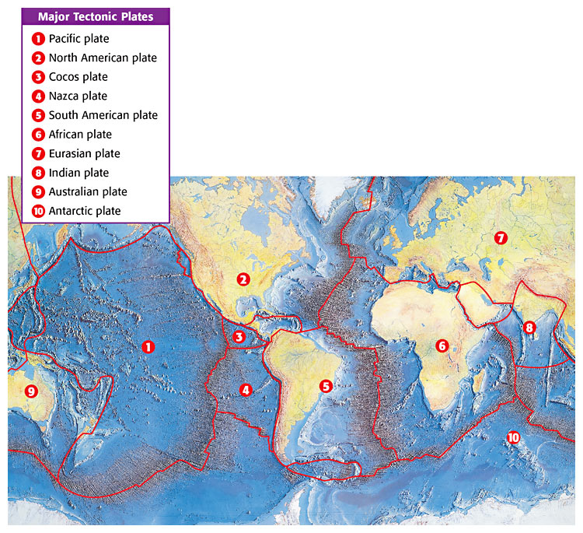
Lithosphere divided into 10 major tectonic plates— know the continental ones and the Pacific plate!

Slide 30
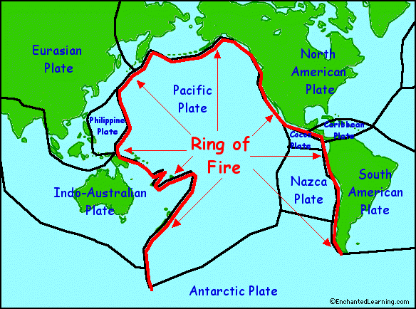
Ring of Fire

Slide 31
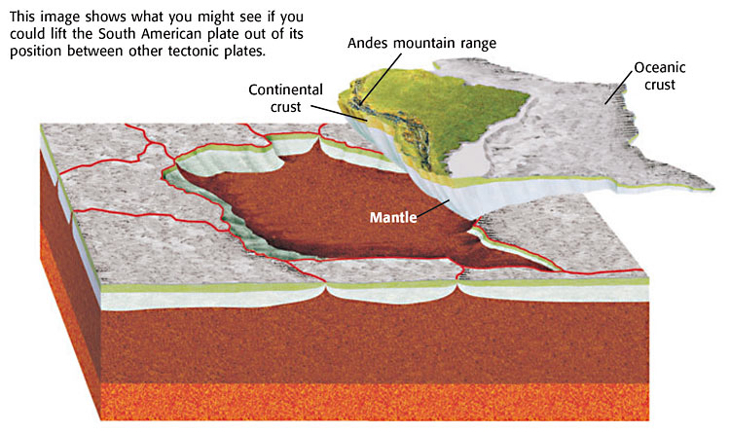
Tectonic plates usually made of oceanic and continental crust

Slide 32
7-3: Theory of Plate Tectonics
Lithospheric tectonics plates float on asthenosphere
3 types of plate boundaries (fill in Tectonic Plate Boundaries sheet)
Convergent
Divergent
Transform
Animation of plate boundaries (website)

Slide 33
Convergent—collide
continent-continent plates creates mountains
…..animation (website)
continent-ocean plates (denser ocean plate moves DOWN and continental plate folds upward) creates trench (at subduction zone) and volcanoes inland
……animation (website)
oceanic-oceanic plates creates island arch (volcanic)
……animation (website)

Slide 34
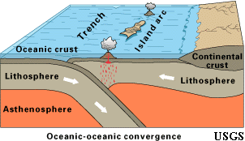
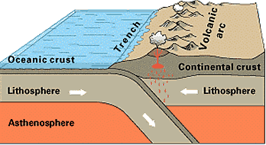
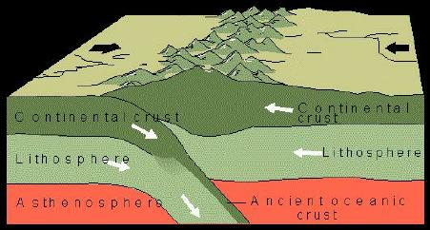

Slide 35
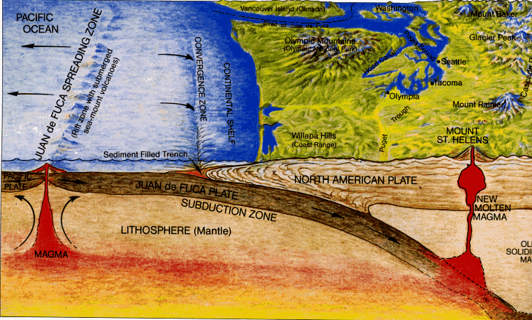
Mt. St. Helens (Washington state)
Created by ocean-continent conversion

Slide 36
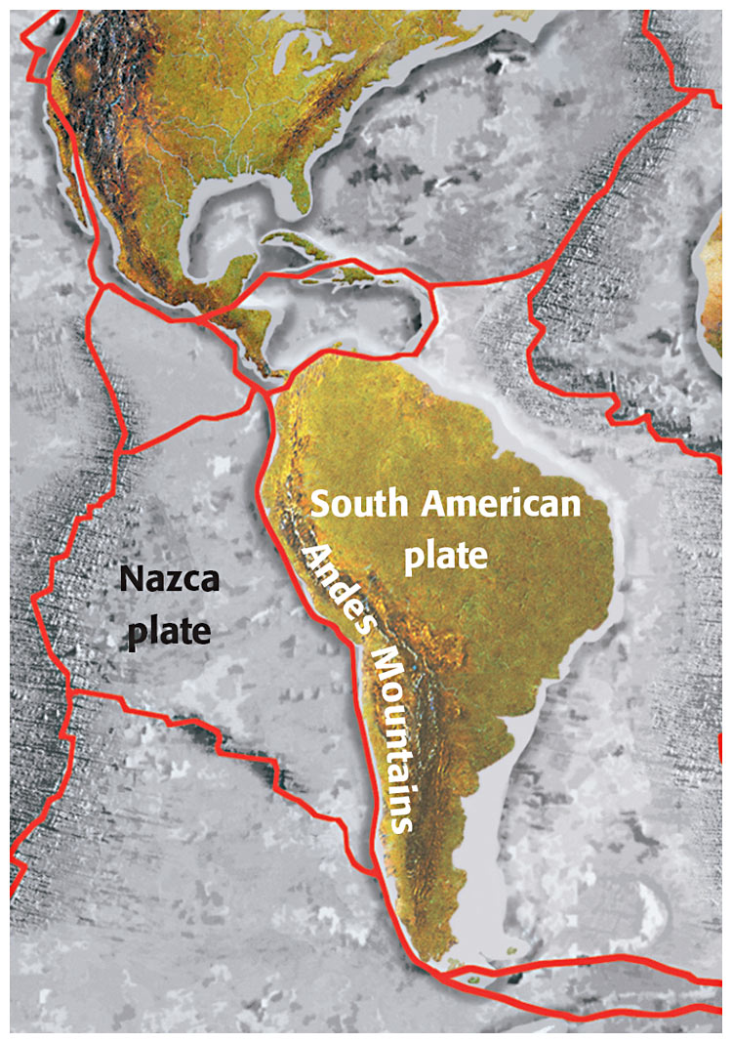
Andes Mountain (convergent boundary)

Slide 37
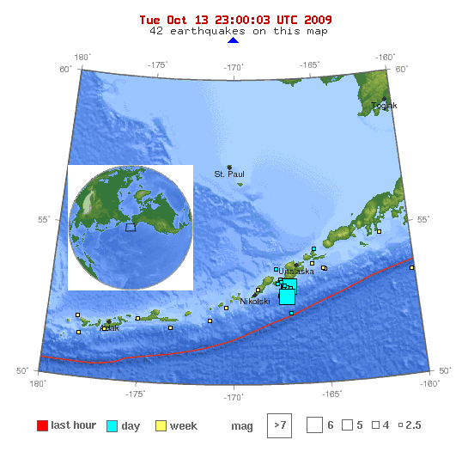
Aleutian Islands (between Alaska and Russia)
formed as 2 oceanic plates collided

Slide 38
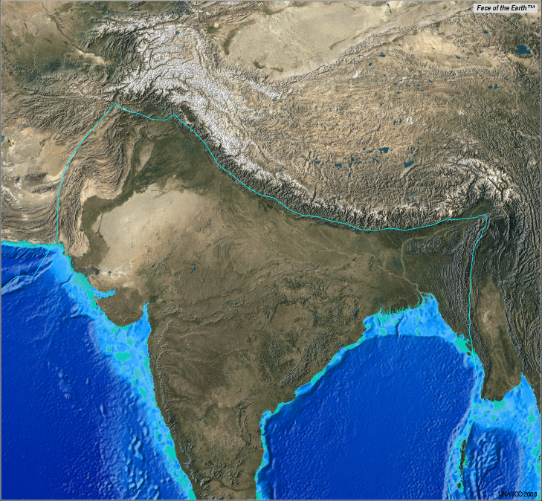
Himalayas (Asia)
formed as 2 continents collided (still growing)

Slide 39
Divergent—plates separate
ocean-ocean=sea-floor spreading (mid-ocean ridge)
continent-continent= rift valley

Slide 40
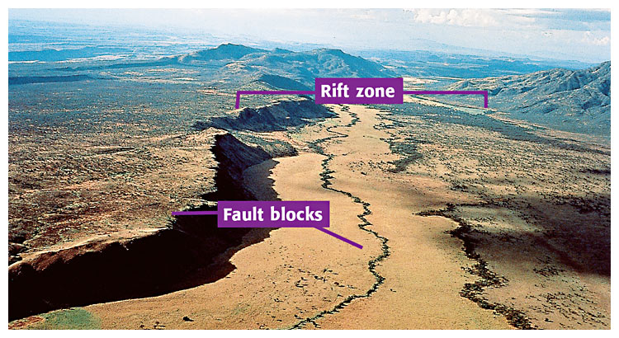
East African Rift (from Ethiopia to Kenya)– divergent boundary

Slide 41
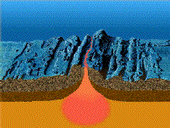
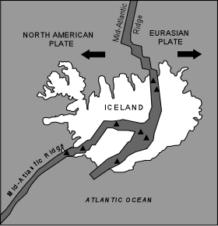
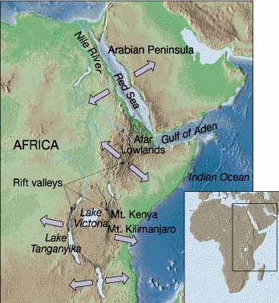

Slide 42
Transform—slide past each other horizontally
ex: San Andreas fault (CA)
may produce earthquakes

Slide 43
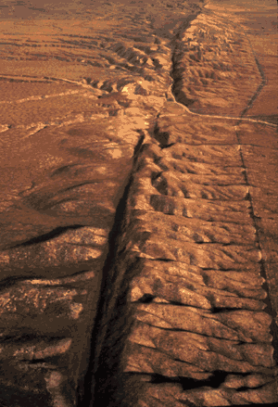
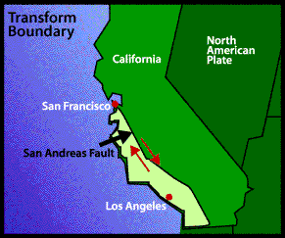
San Andreas Fault (website)

Slide 44
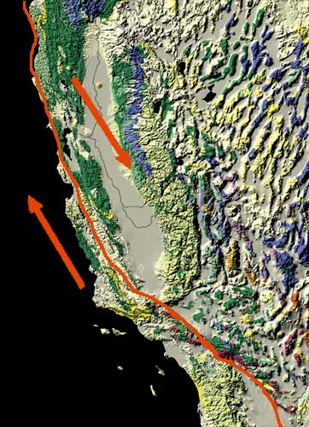
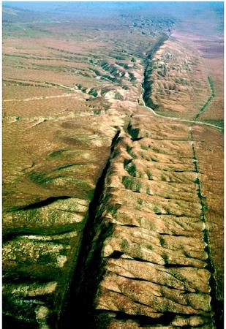
California (2 plates) San Andres Fault

Slide 45
Other Websites
http://www.pbs.org/wgbh/aso/tryit/tectonics/shockwave.html (what happens at the plate boundaries!)
Summary of Plate Tectonics (Enchanted Learning)

Slide 46
plate tectonics online tutorial

Slide 47
Summary of plate boundaries (helps to fill in chart)
http://www.nature.nps.gov/geology/usgsnps/pltec/pltec3.html#divergent

Slide 48
Question
Sea-floor spreading occurs at which of the following types of tectonic plates?
a. transform
b. convergent
c. divergent
d. strike-slip

Slide 49
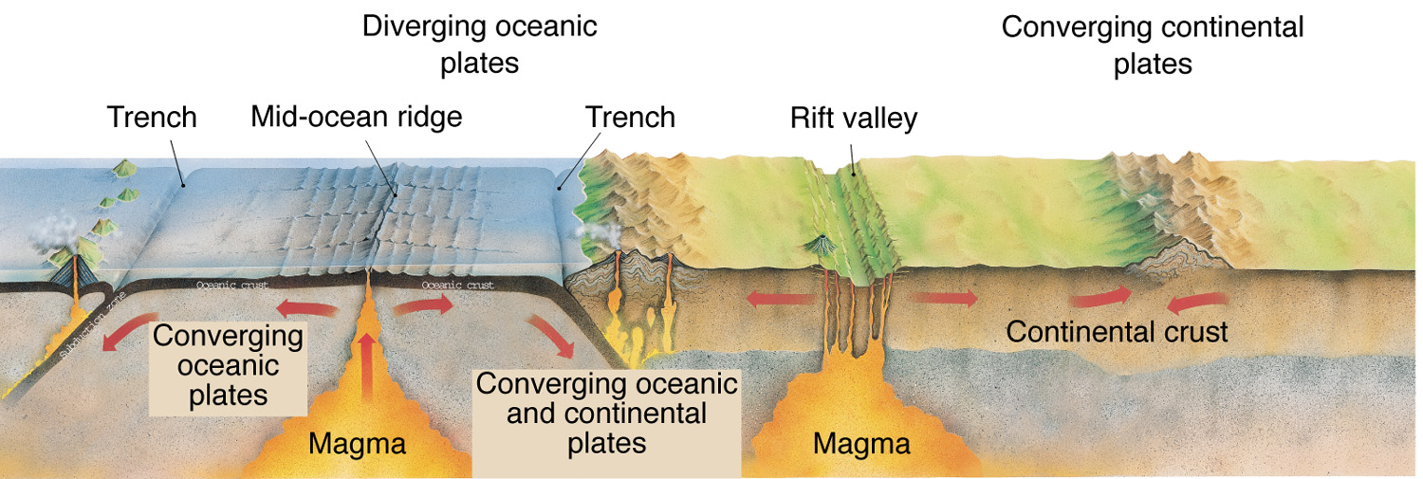

Slide 50
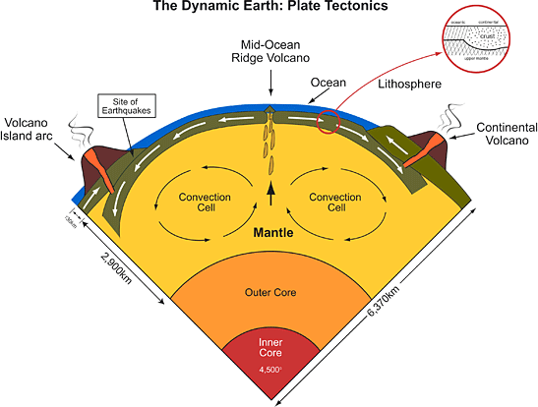
Possible causes of tectonic motion —convection currents (website) in asthenosphere

Slide 51
tracking plate motion with GPS—plates move only a few cm per year
Milky Way (Boundary) Simulation

Slide 52
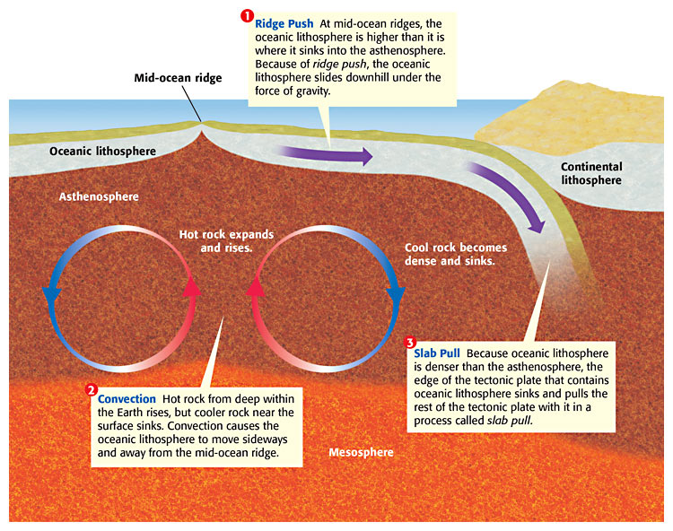

Slide 53
7-4: Deforming Earth’s Crust
stress=amount of force per unit area on a given material (try to bend a piece of uncooked spaghetti or a pop sickle stick and/or silly putty)—2 different speeds
deformation=process by which the shape rock changes because of stress
(ex: bending or breaking)

Slide 54
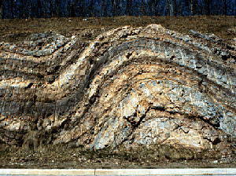
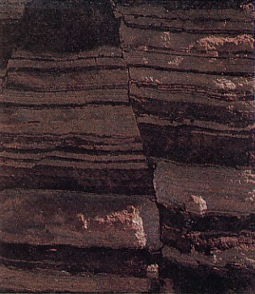
Stress leads to:
Folding =the bending of rock layers due to stress
Fault =a break in a body of rock (one block of rocks slides past the other)

Slide 55
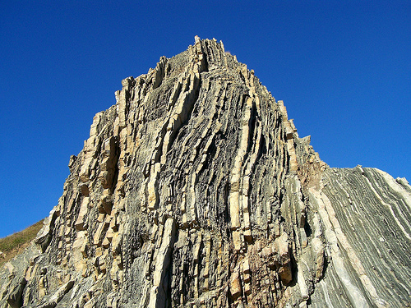
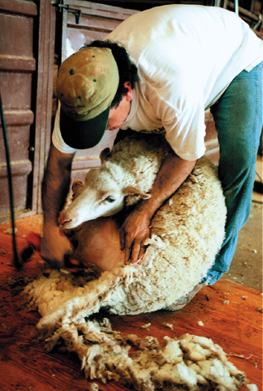
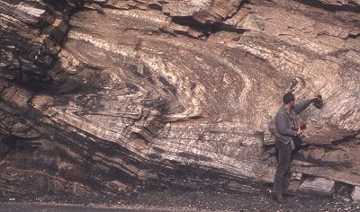
Internal Forces
Shearing ---results in tearing and twisting
Compression —type of stress that occurs when object is squeezed
Tension —type of stress that occurs when forces act to stretch an object
Animated Fault Motion
(website)

Slide 56
Mountain Building
note: must be at least 600 meters from its base
caused by UPLIFT (rising of rock layers)
due to heat rising
and/or pressure from underneath
3 main types of mountains (sketch each and include example of each):
folded
fault-block
volcanic

Slide 57
Folded Mountains
due to compression (squeezed and pushed upward)
examples:
Appalachians (N. America and Africa collided BEFORE Pangaea—about 350 million years ago)
Alps (central Europe),
Ural Mountains (Russia),
Himalayas (Asia) –look at cross-section (Nepal)
Himalayas forming (animated website)

Slide 58
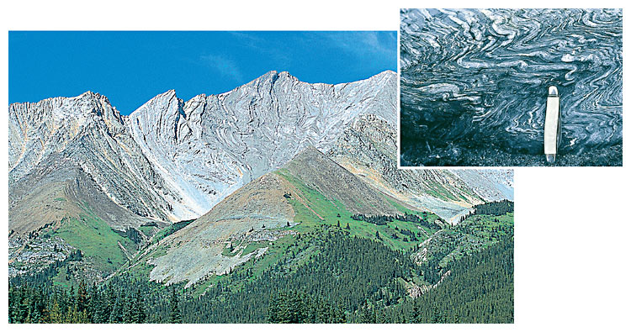
Folds in the Rocky Mountains (plus small folds in rock)

Slide 59
Most of the world’s folded mountains formed as a result of
a. ocean-ocean separation at mid-ocean ridges.
b. continental-continental separation at rift zones.
c. continental-oceanic collision at subduction zones.
d. continental-continental collisions at convergent boundaries.

Slide 60
The Appalachian Mountains and the Himalaya Mountains were both formed by folding. The Himalayas are still growing taller. The Appalachians are losing height and becoming more rounded. Why are these two mountains changing in different ways?
Himalayas’ convergent boundary is still active, while Appalachians’ boundary is no longer active (so they are being weathered and eroded)

Slide 61
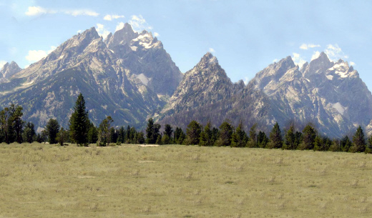
Fault-block Mountains
form when tension causes large blocks of the Earth’s crust to drop down relative to the other block
can have sharp, jagged peaks
ex: Tetons in Wyoming

Slide 62
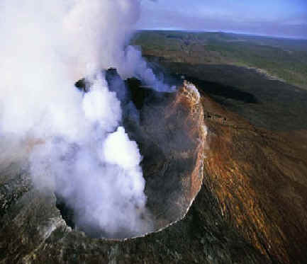
Volcanic Mountains
most inland of subduction zones
some are at mid-ocean ridges
few are “hot spot” volcanoes—like Hawaii
Hot spot (animated website)
Hot spots and Hawaii (website video animation)

Slide 63
What features of Earth are produced by the movement of lithospheric plates?
>>mountains, volcanoes, volcanic islands, rift valleys
What was Alfred Wegener’s hypothesis?
a. The continents have always been where they are now.
b. Today’s continents were once part of a single land mass that split apart.
c. The continents are made of rock.
d. The continents will one day join to form a single continent.

Slide 64
Earthquakes are MOST LIKELY to occur at the borders of _________.
>>>>>lithospheric plates
The collision of two continental plates can produce _____________.
>>>>>>a mountain range (not a single mountain)
Plate tectonics describes movements MAINLY in ___________.
>>>>Earth crust (or lithosphere)

Slide 65
Which ocean was produced by sea-floor spreading between Africa and South America?
>>Atlantic
As distance increases from a mid-ocean ridge, the rocks grow older or younger?
>>>>>older
Assume a sea floor has been separating at an average rate of 5 cm a year. The sea is presently 8,000 km wide. How long ago did the sea begin to form?
Hint: V=d/t
Hint: 8,000 km = 800,000,000 cm
160,000,000 years

Slide 66
More questions
A convection current of magma is made up of
a. a rising more dense liquid and a sinking less dense liquid.
b. a rising less dense liquid and sinking more dense liquid.
c. liquids of the same density.
d. solids of different densities.

Slide 67
The “ring of fire” helps scientists predict areas where ___________ are likely to occur.
>>earthquakes and volcanoes
Volcanoes can be produced by the collisions of ____& _______ plates.
>>oceanic and oceanic OR continental and oceanic

Slide 68
How do mid-ocean ridges support both the idea of continental drift and the theory of plate tectonics?
a. Oceanic lithosphere is destroyed at mid-ocean ridges.
b. New crust forms at mid-ocean ridges.
c. Tectonic plates collide at mid-ocean ridges.
d. The crust at mid-ocean ridges is old oceanic lithosphere.

